Slide 1
Master Pages and Themes

Slide 2
What are Master Pages?
A master page is a new way of organizing a Web site. It can contain a combination of formatting, graphics, and layout—whatever elements you feel that are common to all Web pages on your site content. The idea is to give your Web site a consistent look and reduce the workload on developers.
A master page always has a MASTER file extension.
A master page is always an organization tool for other Web pages; no one actually sees it online.

Slide 3
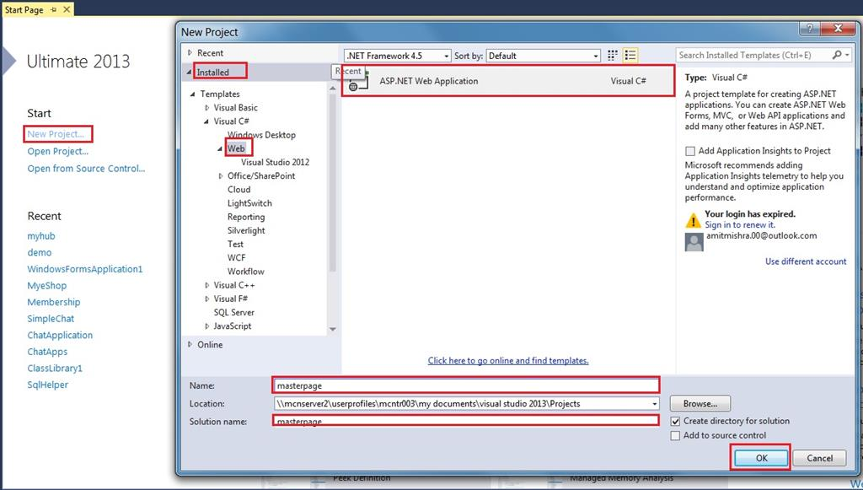

Slide 4
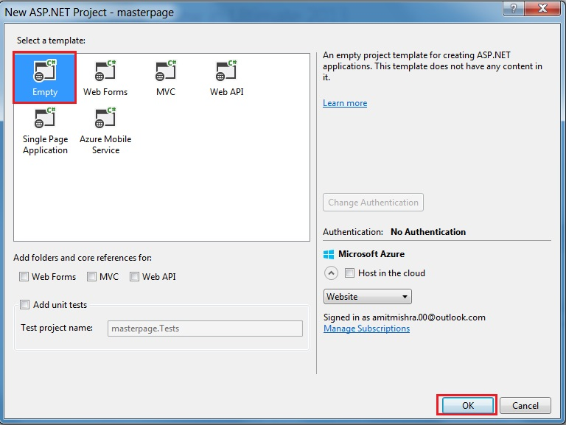
After clicking OK button in the Window, select Empty (shown in the picture),

Slide 5
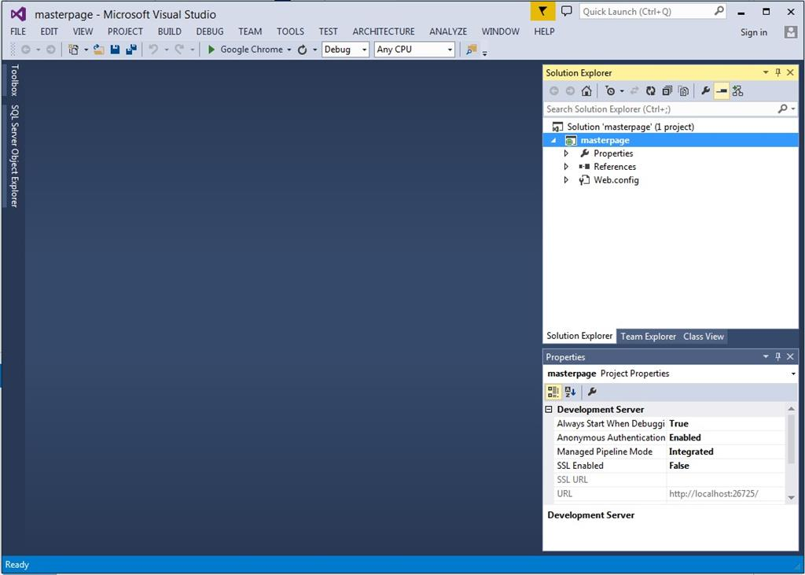
After clicking OK button, project "masterpage" opens but no file is there (shown in the picture)

Slide 6
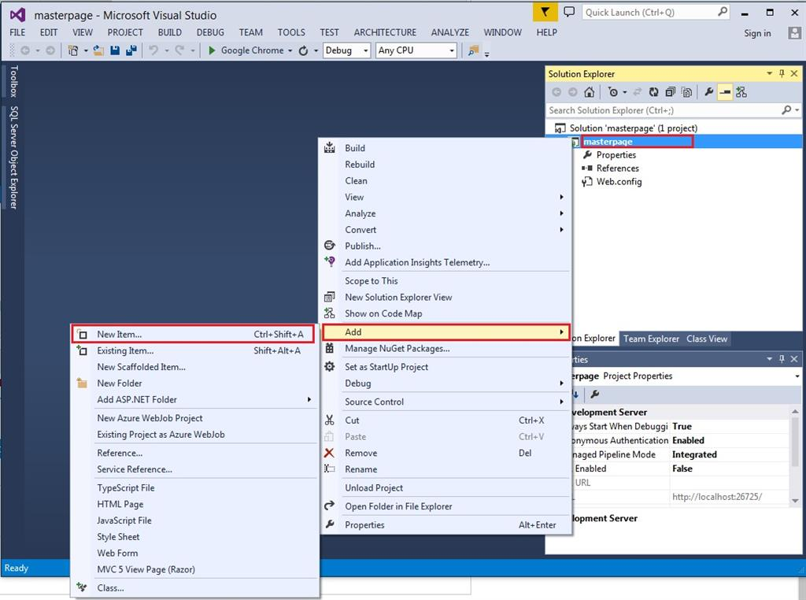
Step 2: Add new file in to our project.
Add the master page into our project.
Right click Project->Add->New item (shown in the picture),

Slide 7
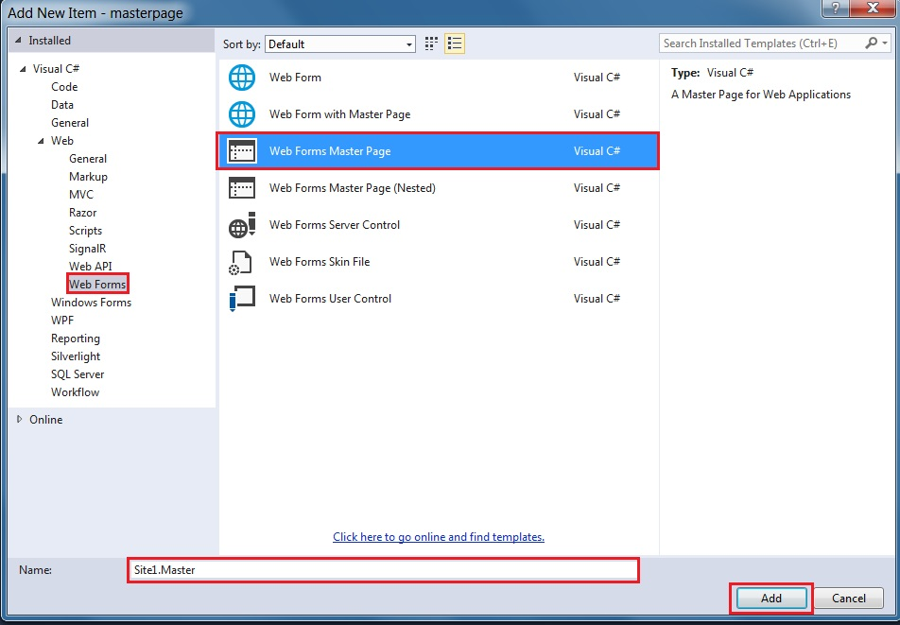
After clicking on new item, Window will open, select Web Form->Web Forms Master Page (shown in the picture),

Slide 8
After clicking on new item, Window will open, select Web Form->Web Forms Master Page

Slide 9
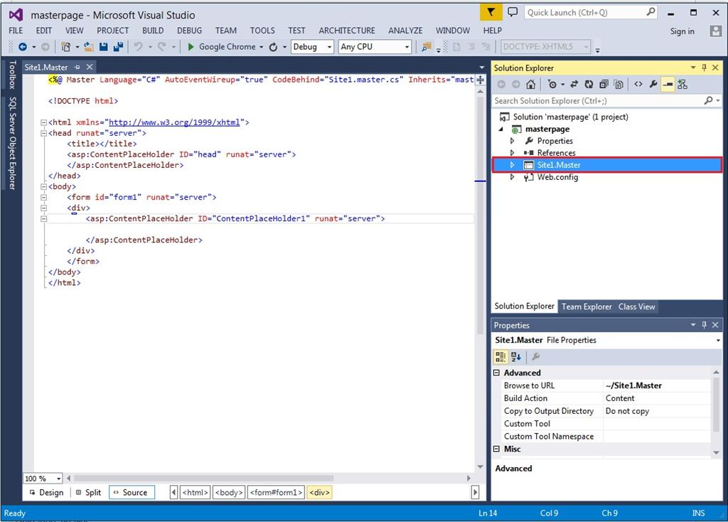
After clicking the add button, master page 'site1.master' adds to our project.
Click on site1.master into Solution Explorer (shown in the picture),

Slide 10
Step 3: Design the master page, using HTML.
MS Word File

Slide 11
Our master page is designed. Move to the next step.
Step 4: Add web form in to our project.
Right click on the project->Add->New item (shown in the picture),

Slide 12
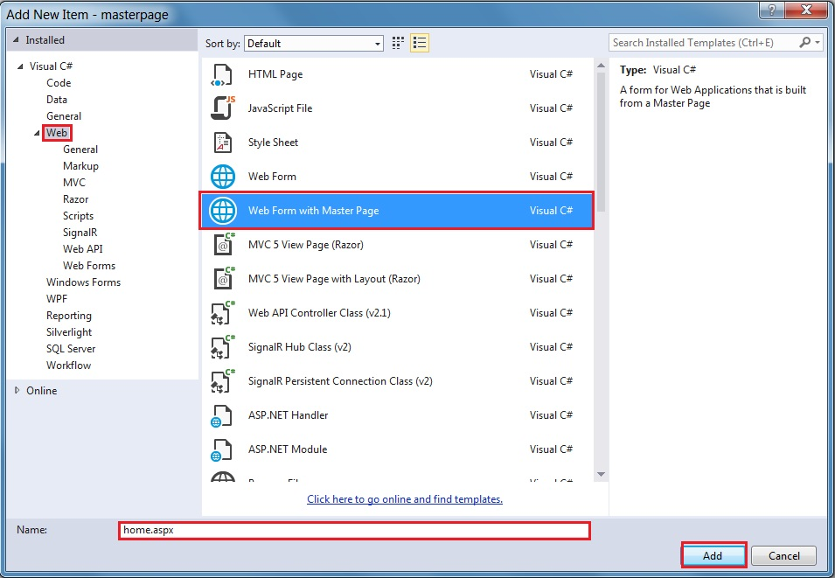
Select Web form with the master page.

Slide 13
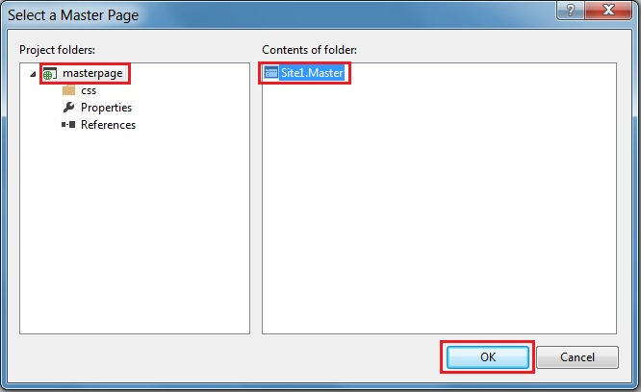
After clicking on that, add the button Window, open the selected masterpage->site1.master and click OK

Slide 14
Now, design our homepage.
Here, we write home page only,
Home.aspx
<%@ Page Title="" Language="C#" MasterPageFile="~/Site1.Master" AutoEventWireup="true" CodeBehind="home.aspx.cs" Inherits="masterpage.home" %>
<asp:Content ID="Content1" ContentPlaceHolderID="head" runat="server">
</asp:Content>
<asp:Content ID="Content2" ContentPlaceHolderID="ContentPlaceHolder1" runat="server">
<h1>Home page</h1>
</asp:Content>
Finally, our Master page is created; build and run the project.
The master page looks aas shown in the picture:

Slide 15
